Slide 1
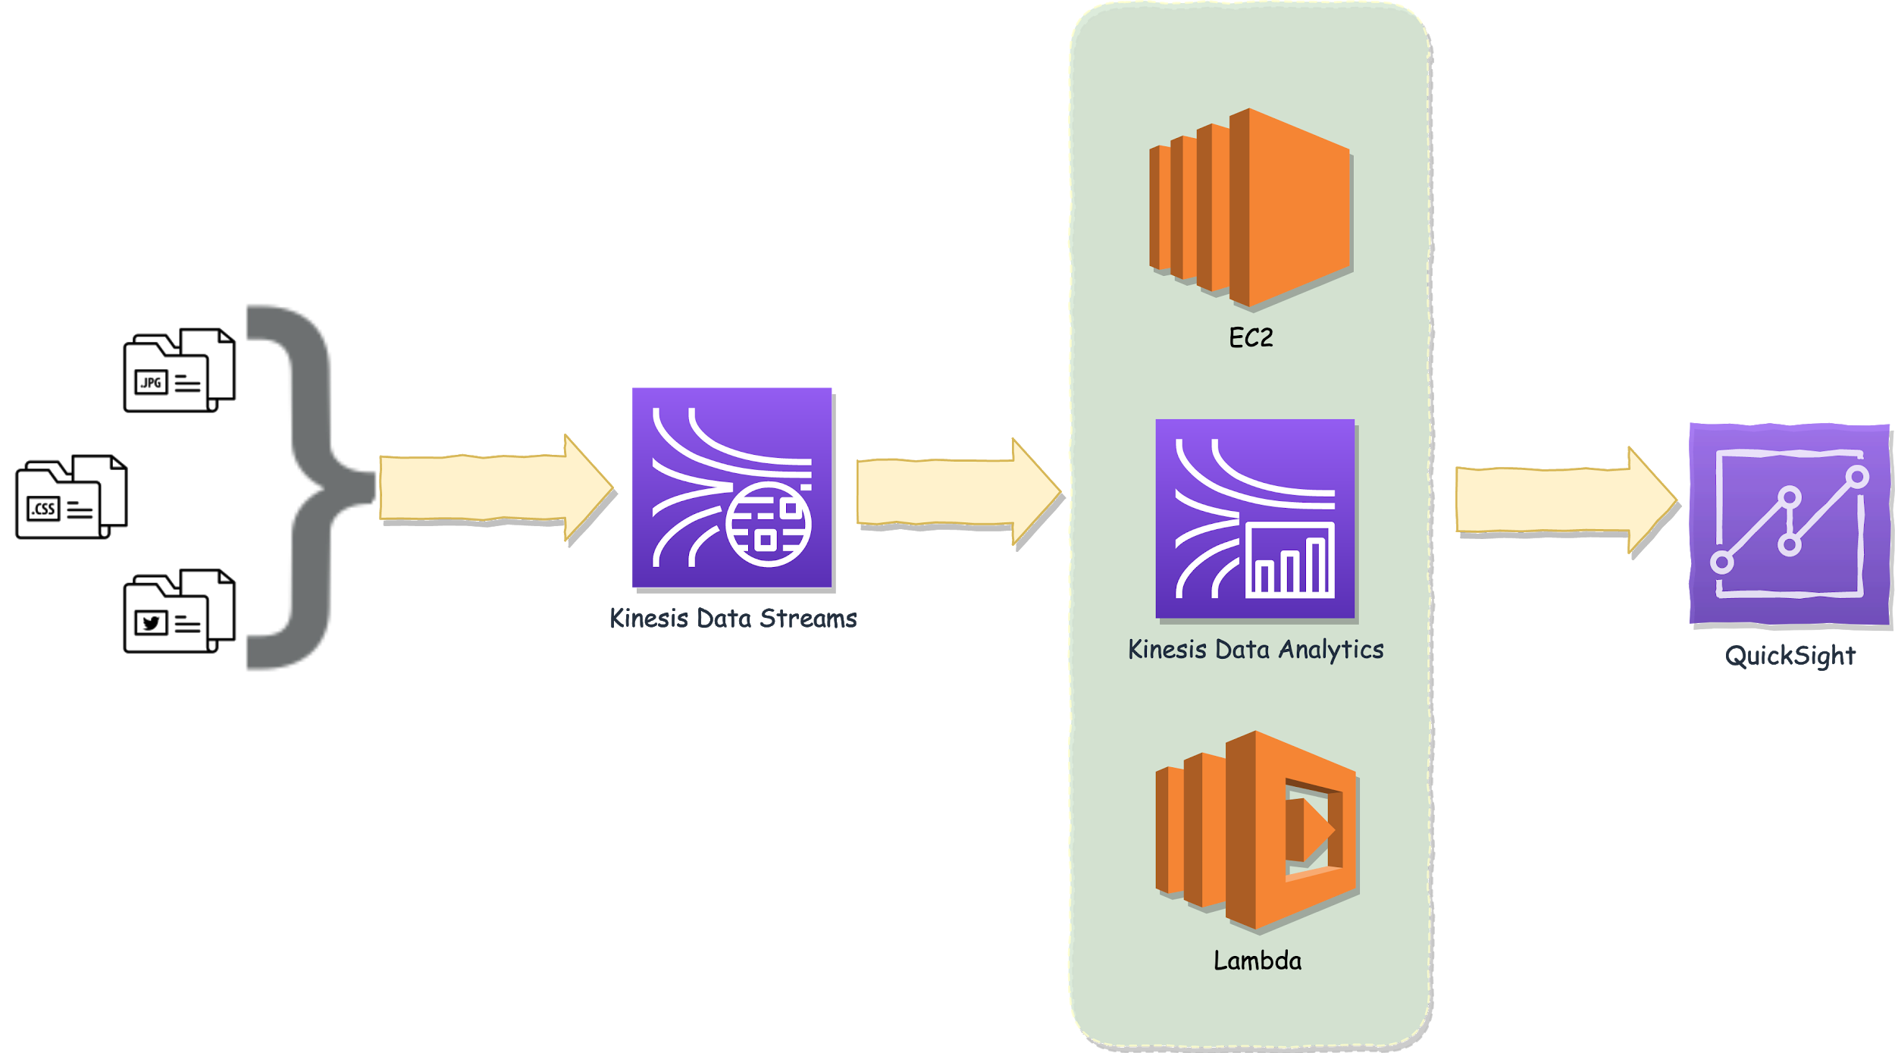
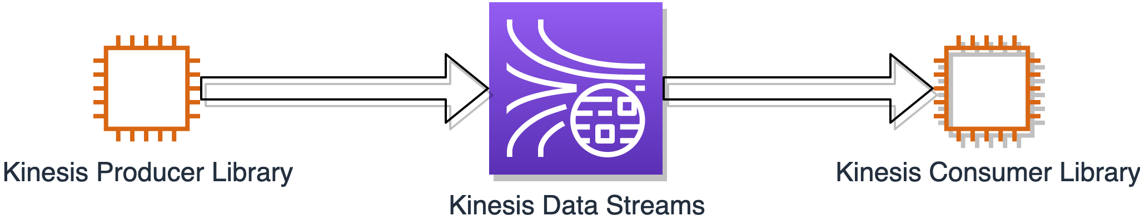

AWS Data Analytics - Domaine 1: Collection
Determine the operational characteristics of the collection system
Understand the operational characteristics of the collection system
Streaming operational components
Fault tolerance and data persistence

Slide 2
AWS Data Analytics - Domaine 1: Collection
Fault Tolerance and Data Persistence
Kinesis Producer Library retries
KPL can send a group of multiple records in each request
If a record fails, it’s put back into the KPL buffer for a retry
One record’s failure doesn’t fail a whole set of records
The KPL also has rate limiting
Limits per-shard throughput sent from a single producer, can help prevent excessive retries

Slide 3
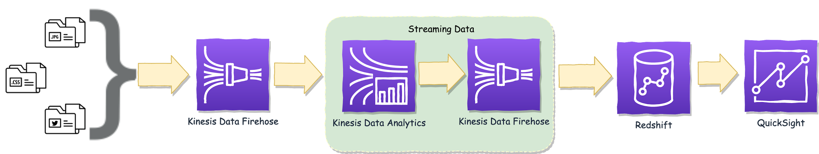
AWS Data Analytics - Domaine 1: Collection
Availability and Durability of your Ingestion Components
Kinesis Data Streams replicates your data synchronously across three AZs in one region
Don’t use Kinesis Data Streams for protracted data persistence
Your data is retained for 24 hours, which you can extend to 7 days
Kinesis Data Firehose streams your data directly to a data destination
Destinations: S3, Redshift, Elasticsearch, Splunk, and also Kinesis Data Analytics
Can transform your data, using a Lambda function, prior to delivering the data

Slide 4
AWS Data Analytics - Domaine 1: Collection
Fault Tolerance of your Ingestion Components
The Kinesis Consumer Library processes your data from your Kinesis Data Stream
Uses checkpointing using DynamoDB to track which records have been read from a shard
If a KCL read fails, the KCL uses the checkpoint cursor to resume at the failed record
Important facts to note for the exam
Use unique names for your applications in the KCL, since DynamoDB tables use name
Watch out for provisioning throughput exceptions in DynamoDB: many shards or frequent checkpointing

Slide 5
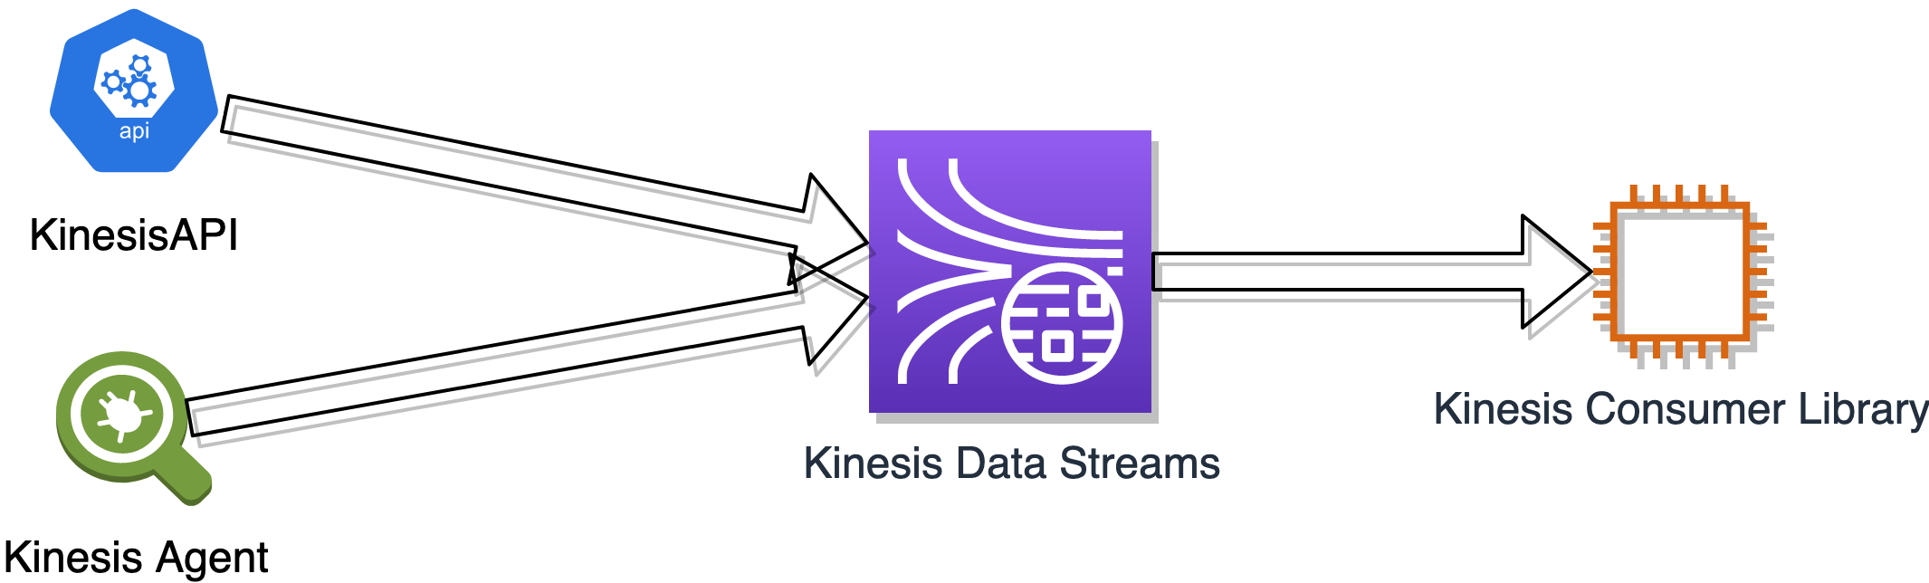
AWS Data Analytics - Domaine 1: Collection
Fault Tolerance of your Ingestion Components
Alternatives to the KPL
Use the Kinesis API instead of KPL when you need the fastest processing time
KPL uses RecordMaxBufferedTime to delay processing to accommodate aggregation
Kinesis Agent
Kinesis Agent installs on your EC2 instance
Monitors files, such as log files, and streams new data to your Kinesis stream
Emites CloudWatch metrics to help with monitoring and error handling

Slide 6
AWS Data Analytics - Domaine 1: Collection
Determine the operational characteristics of the collection system - Summary
The characteristics of your data streaming workload guide you in the selection of your streaming components
The two key components to remember for the exam
Fault tolerance
Data persistence
Kinesis Data Streams vs Kinesis Data Firehose
Data persistence
Kinesis Producer Library vs Kinesis API vs Kinesis Agent
Fault tolerance and appropriate tool for your data collection problem

